Slide 1
Srinivasa Pradeep S
Final Project
01/04/2024 Annual Review

Slide 2
PROJECT TITLE Generative Adversarial Network (GAN) for Handwritten Digit Generation
Developing a Generative Adversarial Network (GAN) capable of generating realistic handwritten digits resembling those from the MNIST dataset.
01/04/2024 Annual Review

Slide 3


AGENDA
Problem Statement
Project Overview
End Users
Solution and Value Proposition
Unique Aspects of the Solution
Modelling
Results
Conclusion
References
01/04/2024 Annual Review

Slide 4

PROBLEM STATEMENT
The project is focused on creating a Generative Adversarial Network (GAN) with the capability to generate lifelike handwritten digits similar to those found in the MNIST dataset. MNIST comprises 28x28 grayscale images of handwritten digits ranging from 0 to 9. The primary goal is to develop a GAN that can produce synthetic images that closely resemble the digits in the MNIST dataset. This involves training the GAN to generate not
only images that mimic the visual appearance of the digits but also
exhibit characteristics such as variability and realism comparable
to the original dataset.
01/04/2024 Annual Review

Slide 5

PROJECT OVERVIEW
The project involves several key steps, including data acquisition, model design, training, evaluation, and deployment. It leverages deep learning frameworks like TensorFlow and Keras to build and train the GAN architecture. Additionally, the project emphasizes experimentation and optimization to achieve high-quality results. By adhering to best practices in machine learning and computer vision, the project ensures the development of a reliable and effective solution
01/04/2024 Annual Review

Slide 6

WHO ARE THE END USERS?
Potential end users include researchers exploring generative models, developers implementing image synthesis applications, and practitioners in fields like digit recognition, pattern recognition, and artificial intelligence. The project's outputs, such as the trained GAN model and generated digit images, can be valuable resources for academia, industry, and hobbyists interested in machine learning and computer vision.
01/04/2024 Annual Review

Slide 7

OUR SOLUTION AND ITS VALUE PROPOSITION
The solution offers a comprehensive approach to generating realistic handwritten digit images using GANs. By leveraging state-of-the-art techniques and frameworks, the project delivers a robust and efficient solution that can be easily adapted and extended for various applications. The value proposition lies in the ability to generate high-quality synthetic data, which can enhance the performance of digit recognition models and facilitate research in image synthesis and generative modeling.
01/04/2024 Annual Review

Slide 8

THE WOW IN OUR SOLUTION
Advanced Architecture Design: The project explores various architectural choices for both the generator and discriminator networks, ensuring the generation of diverse and realistic digit images.
Optimization and Tuning: Extensive experimentation and hyperparameter tuning are conducted to optimize the performance of the GAN model, resulting in superior image quality and stability.
Deployment and Documentation: The project provides detailed documentation and instructions for deploying the trained GAN model, making it accessible to a wide audience of users and developers.
01/04/2024 Annual Review
8

Slide 9
MODELLING
GAN Architecture Design:
Generator:
Design a neural network with multiple layers of fully connected (Dense) and activation layers (e.g., ReLU, Tanh).
Experiment with variations in network depth, layer sizes, and normalization techniques (e.g., Batch Normalization).
Discriminator:
Design a neural network with similar architectural choices as the generator but with a binary classification output.
Utilize activation functions such as Leaky ReLU and Sigmoid to introduce non-linearity and produce probability scores.
Data Preparation:
Download the MNIST dataset.
Preprocess the images by normalizing pixel values to the range [-1, 1].
Generator Network:
Define the generator network architecture using TensorFlow/Keras.
Implement a neural network with fully connected layers and activation functions (e.g., ReLU, Tanh).
Compile the generator model. Discriminator Network:
Design the discriminator network architecture using TensorFlow/Keras.
Implement a binary classifier using fully connected layers and activation functions (e.g., Leaky ReLU, Sigmoid).
Compile the discriminator model.
01/04/2024 Annual Review
9

Slide 10
MODELLING
GAN Training:
Define the GAN model by connecting the generator and discriminator networks.
Train the GAN model using adversarial training:
Train the discriminator with real and fake images.
Train the generator to generate realistic images that fool the discriminator.
Monitor training progress and adjust hyperparameters as necessary.
Performance Evaluation:
Evaluate the performance of the trained GAN by generating synthetic digit images.
Visualize generated images and compare them with real digit images.
Compute quantitative metrics to assess image quality.
Hyperparameter Tuning:
Conduct hyperparameter tuning experiments to optimize GAN performance.
Explore variations in learning rate, batch size, optimizer choice, and network architecture.
Select hyperparameters that lead to the best performance based on evaluation metrics.
Deployment:
Deploy the trained GAN model and associated code into a GitHub repository.
Include instructions for setting up the environment and running the code.
Create documentation and README files explaining the project, algorithm, and deployment instructions.
01/04/2024 Annual Review
10

Slide 11
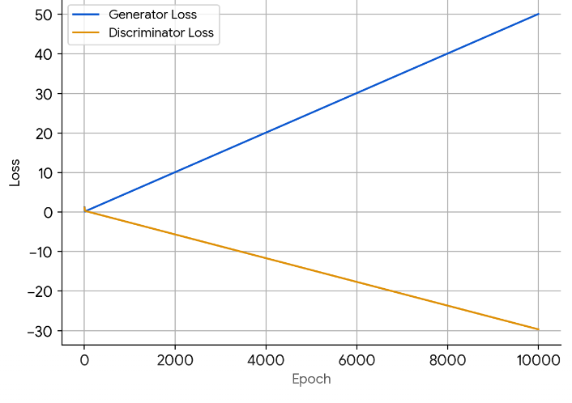
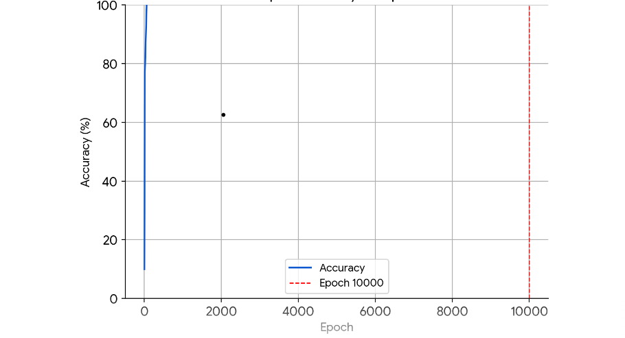
RESULTS
01/04/2024 Annual Review
11

Slide 12
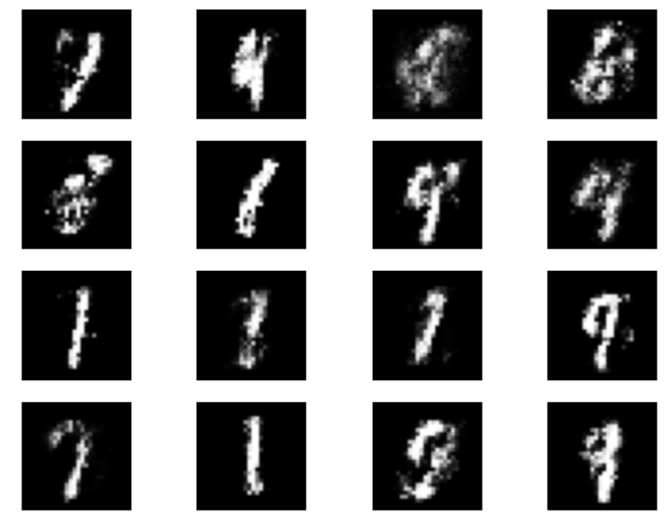
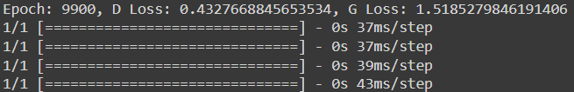
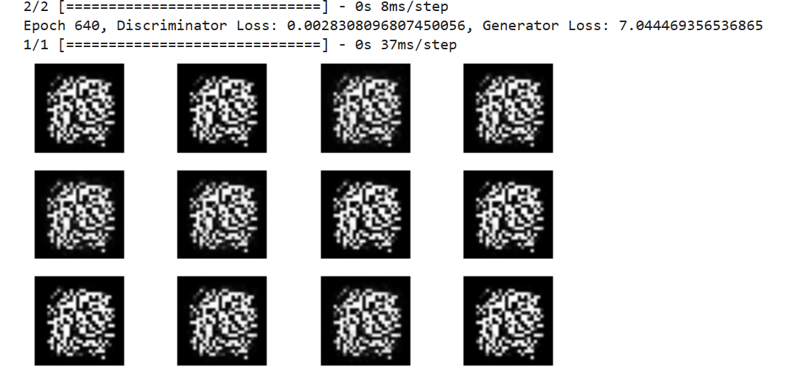
RESULTS
Demo Link
01/04/2024 Annual Review
12

Slide 13
CONCLUSION
The project illustrates how GANs can effectively create lifelike handwritten digit images, shedding light on both the difficulties and possibilities in training and utilizing generative models. Future endeavors will persist in exploring and expanding the realms of generative modeling and its real-world implementations.
01/04/2024 Annual Review
13

Slide 14
REFERENCES
https://www.tensorflow.org/
https://keras.io/
https://numpy.org/
https://matplotlib.org/
scikit-learn: machine learning in Python — scikit-learn 1.4.1 documentation
MNIST handwritten digit database, Yann LeCun, Corinna Cortes and Chris Burges
01/04/2024 Annual Review
14

Slide 15
Thank you
01/04/2024 Annual Review

